Slide 1
XGBoost
Topics
What is XGBoost with regression trees?
Quant Model with XGBoost
Model Hyperparameters
Portfolio performance

Slide 2
What is XGBoost with regression trees?
XGBoost (eXtreme Gradient Boosting) is an advanced gradient boosting algorithm that enhances predictive accuracy and computational efficiency. With regression trees, XGBoost builds a sequence of decision trees in a boosting framework.
Boosting – Key characteristics
Trains regression trees sequentially
The residuals from a previous tree is the target for the next tree
Final Prediction
A weighted sum of predictions from the sequence of trees

Slide 3
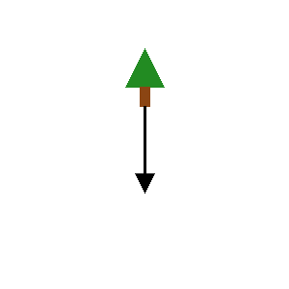

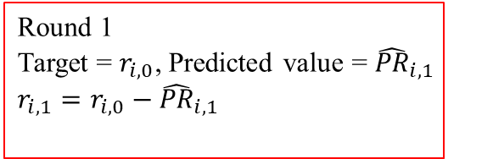
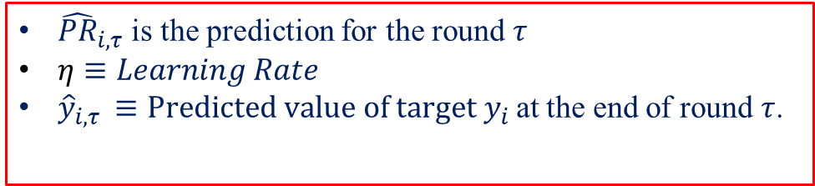
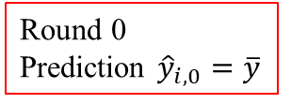
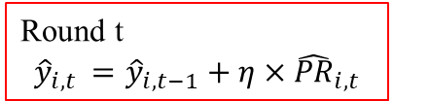
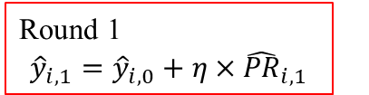
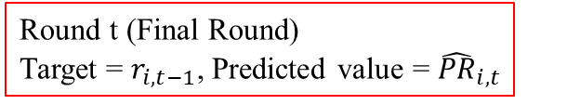
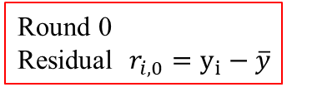



XGBoost
Round 0
Prediction ${\hat{y}}_{i,0}=\overline{y}$
Round 0
Residual $r_{i,0}=y_{i}−\overline{y}$
Round 1
$${\hat{y}}_{i,1}={\hat{y}}_{i,0}+η×{\hat{PR}}_{i,1}$$
Round 1
Target = $r_{i,0}$, Predicted value = ${\hat{PR}}_{i,1}$
$$r_{i,1}=r_{i,0}−{\hat{PR}}_{i,1}$$
$$⋮$$
$$⋮$$
$$⋮$$
$$⋮$$
$$⋮$$
$$⋮$$
Round t
$${\hat{y}}_{i,t }={\hat{y}}_{i,t−1}+η×{\hat{PR}}_{i,t}$$
Round t (Final Round)
Target = $r_{i,t−1}$, Predicted value = ${\hat{PR}}_{i,t}$
${\hat{PR}}_{i,τ}$ is the prediction for the round $τ$
$η≡Learning Rate$
${\hat{y}}_{i,τ }≡Predicted value of target y_{i}$at the end of round $τ$.

Slide 4
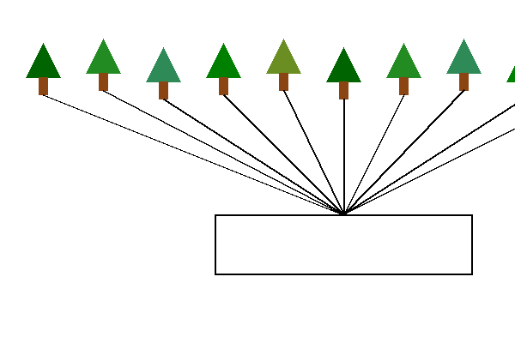
Random Forest
Ensemble Prediction

Slide 5
Flowchart

Slide 6
Hyperparameters
Hyperparameters are set before training and control how the model learns. XGBoost hyperparameters dictate how each tree is built, when to stop building trees, etc.
The command below specifies certain hyperparameters
params = {'eval_metric': 'rmse', 'max_depth': 4, 'gamma': 0.2, 'subsample': 1.0, 'colsample_bytree': 0.8, 'alpha': 0, 'lambda': 1, 'learning_rate' : 0.3, 'seed': 0}

Slide 7
XGBoost Hyperparameters: A glossary
'learning_rate': 0.3 → Step size shrinkage to control updates during training.
'eval_metric': 'rmse' → Root Mean Squared Error (RMSE) is used as the evaluation metric.
'lambda': 1 → L2 regularization term (Ridge).
'gamma': 0.2 → Minimum loss reduction required for further splitting a node.
'max_depth': 4 → Limits the depth of the trees to control complexity and overfitting.
'subsample': 1.0 → Fraction of training instances to be used for each tree (1.0 means use all)
'colsample_bytree': 0.8 → Fraction of features used for each tree.

Slide 8
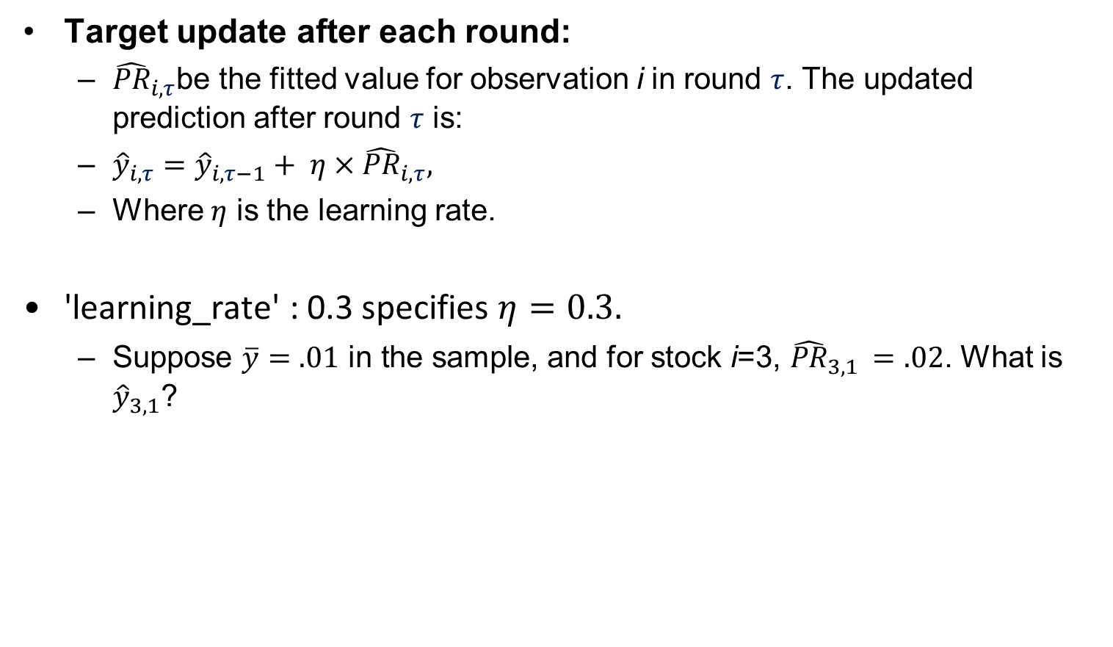
Prediction Update
Target update after each round:
${\hat{PR}}_{i,τ}$be the fitted value for observation i in round $τ$. The updated prediction after round $τ$ is:
${\hat{y}}_{i,τ}={\hat{y}}_{i,τ−1}+ η×{\hat{PR}}_{i,τ},$
Where $η$ is the learning rate.
'learning_rate' : 0.3 specifies $η=0.3.$
Suppose $\overline{y}=.01 \text{in} \text{the} \text{sample}\text{, }$and for stock $\text{i}\text{=3, }{\hat{PR}}_{3,1 }=.02$. What is ${\hat{y}}_{3,1}$?

Slide 9
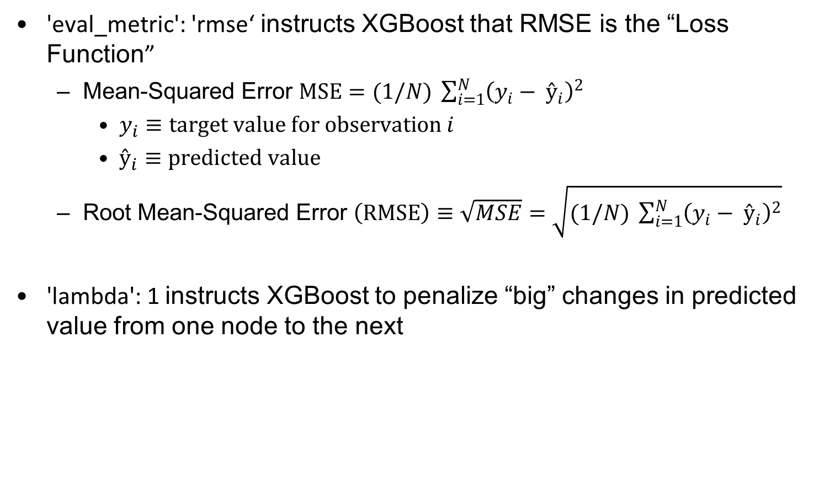
RMSE
'eval_metric': 'rmse‘ instructs XGBoost that RMSE is the “Loss Function”
Mean-Squared Error $MSE=(1/N) \sum_{i=1}^{N}{{\left(y_{i}− ŷ_{i}\right)}^{2}}$
$y_{i}≡target value for observation i$
$ŷ_{i}≡predicted value$
Root Mean-Squared Error $\left(RMSE\right)≡\sqrt{MSE}=\sqrt{(1/N) \sum_{i=1}^{N}{{\left(y_{i}− ŷ_{i}\right)}^{2}}}$
'lambda': 1 instructs XGBoost to penalize “big” changes in predicted value from one node to the next

Slide 10
Improvements in each step
XGBoost computes the gain each time it splits a node.
'gamma': 0.2 instructs the code to stop splitting if the gain is less than 0.2
Gradient and Hessain are slopes of the slopes function at each node that are used to compute gains by splitting a node

Slide 11
Hyperparameters: Tree specification
'max_depth': 4 → Limits the depth of the trees to control complexity and overfitting.
'subsample': 1.0 → Fraction of training instances to be used for each tree (1.0 means use all)
'colsample_bytree': 0.8 → Fraction of features used for each tree.

Slide 12
Stopping Rule
Hyperparameters (default values) :
n_estimators=1000, stop after 1000 trees
early_stopping_rounds=10, stop if 'rmse‘ does not improve for 10 rounds

Slide 13
XGBoost: Back test
Specify hyperparameters
Tuning: optimizing the hyperparameters to get improved performance
Train the model
Get out-of-sample predicted returns for each stock, for each month
Decile portfolio returns
Evaluate performance

